Slide 1
Creative Writing
Journal prompts

Slide 2
Journal Guidelines
Students will have a notebook they use only for journaling in this class.
Students should date and title each entry.
Don’t waste; write on both sides of paper and don’t skip spaces. Just start each new entry on its own page.
Write for the entire time, without ceasing.
We will discuss the journals after time has ended, but, only on a volunteer basis.
Though confidentiality is respected, issues in which the student or another has been or may be harmed will result in the teacher contacting the school counselor and administrators.
Journals will be handed in and graded on the following:
Quality of ideas
Length (I expect ¾ of a page of more for each entry.)
Meets all of the requirements listed.

Slide 3
The writing prompt doesn’t speak to me so can I skip it?
The writing prompt doesn’t have to speak to you. The idea is to work through the exercise offered up to you. You may be surprised what happens once you commit to the prompt writing process. You may start off in one direction with the prompt but once your creativity takes over it may lead you in another, something that might never have happened if you skipped the prompt all together. Besides it’s great practice for writing outside your personal comfort zone.

Slide 4
How do I use a visual prompt?
Whether you are a visual person or not, using an image writing prompt is a good exercise for your creative energies.
Image prompts are incredibly versatile. If you spend a few minutes looking at an image you can probably come up with at least five different scenarios of what is happening. In fact that is a good place to start with any image prompt. While you are viewing the image quickly jot down five situations or thoughts that come to mind. When you are done pick one and elaborate on it.
Images provide a visual cue to get us started but there are so many avenues to explore. The same image can provide a writer with a new prompt every day of the week (or more if she is persistent). It depends on the mood of the writer and her creative influence at the moment of viewing. With so many images around us a writer has no excuse for not writing something new.

Slide 5
Journal entry #1
“All shall be well and all shall be well and all manner of things shall be well.”
– Julian of Norwich

Slide 6
Journal entry #2
Imagine that you have borrowed (borrowed?) a car and have been involved in a fender bender. Write an explanation for the police report.
Then, write a monologue (a speech for one voice) explaining the accident to the friend (parent?) whose car you borrowed.
Then, write a letter telling about it to a friend who thinks you are truly cool.
NOTE that you are writing three separate things for this entry.

Slide 7
Journal entry #3
Ever since Janie Masterson’s father died she would celebrate his birthday by going camping in the remote area of Kettle Pond State Park. When she was little he used to take her there a couple times a year. To help develop her survival instincts, he told her. It was probably one of the main reasons she…
I have lived three lifetimes but I have never been born and I have never died. You may think you know me but it is more likely that I know you and…

Slide 8
Journal entry #4
The Dirty Dozen: Write something using these 24 words. The order of the words can be switched around as necessary. The choice of whether you write fiction or non-fiction is up to you. And don’t use all the words in the first sentence. You must use 12 of the 24 words.
shave
henpecked
usher
flourish
loose
grandson
pouch
cashews
disobey
rocky
passport
Volkswagen
shortsighted
German
fireworks
shoulders
disappearance
volunteer
mountainous
extreme
tadpole
journeyman
mock
truck

Slide 9
Journal entry #5
“Normality is a fine ideal for those who have no imagination.” – Carl Jung

Slide 10
Journal entry #6
Write about a situation in which you were badly stressed. But write about it in the first person from the point of view of someone else who was present, the point of view of someone who observed you.

Slide 11
Journal entry #7
Maddy spun round and round, her fingers grasping at the layers of her bright teal tutu and fanning them then letting them fall. She stopped mid-twirl momentarily to see if I was watching her and…
My mother and I Skyped every Sunday night after supper. I had not lived in the same town as her for three years and I worked fourteen hour days six days a week as…

Slide 12
Journal entry #8
The Dirty Dozen: Write something using these 24 words. The order of the words can be switched around as necessary. The choice of whether you write fiction or non-fiction is up to you. And don’t use all the words in the first sentence. You must use 12 of the 24 words.
ethereal
hateful
monies
trace
arouse
worrywart
piercings
cheat
clinch
revamped
blinds
rack
shimmy
excitement
wheel
about-face
dependable
oboe
secret
adorn
ratify
handles
witness
carry

Slide 13
Journal entry #9
“God wisely designed the human body so that we can neither pat our own backs nor kick ourselves too easily.” – Unknown

Slide 14
Journal entry #10
Write from the point of view of anything not human—an insect, an android, a potato, a belly button or anything else. Try to invent and develop a diction (word choice that matches your chosen voice) that represents the frame of reference of this thing. For instance, if you are writing from the point of view of a shoe, it is likely to have extensive knowledge of and opinions about flooring, but a limited concept of the sky or human heads.
You are to use first person point of view.

Slide 15
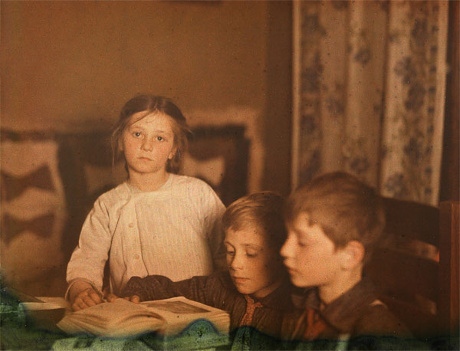
Journal entry #11
“He who could learn to fly must first learn to walk and run and climb and dance; one cannot fly into flying.” – Nietzsche

Slide 16
Journal entry #12
Lying in the dark, Meg could hear someone fiddling with the doorknob of her dorm room. She sucked in a deep breath and…
It was 5 a.m. on a damp morning in April. All the heat had been sucked out of my fingers and toes but I still did not turn the ignition of my light blue Volkswagen bug. I wanted to be home in bed with my new puppy snuggled against me. Instead I was staking out…

Slide 17
Journal entry #13
The Dirty Dozen: Write something using these 24 words. The order of the words can be switched around as necessary. The choice of whether you write fiction or non-fiction is up to you. And don’t use all the words in the first sentence. You must use 12 of the 24 words.
burst
Glow stick
collar
hacking
excitement
Lego
swarm
pairing
mousse
chest
stairway
hyperventilate
accelerated
sluggish
comical
wedges
coffee
scrambled
mishandled
overreaction
Henry
pearls
ticket
almond

Slide 18
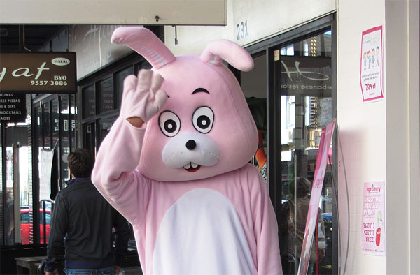
Journal entry #14
“Maturity is the ability to do a job whether or not you are supervised, to carry money without spending it, and to bear an injustice without wanting to get even.”
- Ann Landers

Slide 19
Journal entry #15
Marti kneeled close to the floor to look under the couch. She lifted up the flap of green chenille to find…
Morgan always dreaded the first day of a new school. First there was the anxiety of meeting the new teachers and the new school mates. Then there was getting a mental map ingrained in your head of where your homeroom was, where you locked your possessions, where to eat, and where to go if you have a problem with your schedule. If that was not enough there was an endless convoy of beady eyes checking you out as you walked down the hallway. Today was…

Slide 20
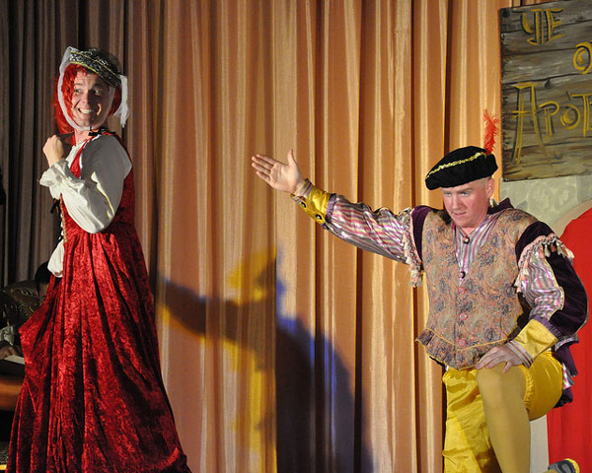
Journal entry #16
“Great spirits have always encountered violent opposition from mediocre minds.”
– Albert Einstein

Slide 21
Journal entry #17
The Dirty Dozen: Write something using these 24 words. The order of the words can be switched around as necessary. The choice of whether you write fiction or non-fiction is up to you. And don’t use all the words in the first sentence. You must use 12 of the 24 words.
shadowy
clock
reasoning
gnaw
pivot
leaves
blatant
rims
infant
linger
artichoke
redeem
capture
estate
branch
gorge
judicious
animated
glow
remedy
mistress
carrots
cosmopolitan
mishmash

Slide 22
Journal entry #18
Thanks to Star Trek I grew up thinking space was the final frontier when in reality it was really…
No one appreciates fairy godmothers. I give, give, give and do I even get a thank you in return? That’s right, no. Well, now it’s my turn. I’m going to be my own fairy godmother and the first thing I’m going to take care of is…

Slide 23
Journal entry #19
“Some people die at 25 and aren’t buried until 75.” ~ Benjamin Franklin

Slide 24
Journal entry #20
Most people don’t believe in miracles. At least not until one happens to them, or someone they know, or a friend of someone they know. My miracle happened when I was fourteen. I was helping my father clean leaves out of the gutter when…
The new kid in town is Riley James. He’s funny, cute, and everyone adores him. He also happens to be in a wheelchair but no one knows…

Slide 25
Journal entry #21
The Dirty Dozen: Write something using these 24 words. The order of the words can be switched around as necessary. The choice of whether you write fiction or non-fiction is up to you. And don’t use all the words in the first sentence. You must use 12 of the 24 words.
wake-up
forest
spirit
flashlight
gracious
headband
mechanic
tryout
units
sweaty
atmosphere
deli
dramatic
light
tempted
risky
sundown
delusional
quarter
fearful
star
detergent
fired
brother

Slide 26
Journal entry #22
Of all the days for our store to get robbed, of course it had to be Friday the 13th. You would not think an every day run-of-the-mill bookstore would be a target for robbers but they were not just any kind of robbers. And it definitely was not books they were after. The day started off like any other. I arrived 7:45 a.m. to…
All we could find that was remotely close to food was a Snickers bar, a half a package of Twizzlers, four lozenges and a bottle of coke. Hardly enough for survival in the …

Slide 27
Journal entry #23
“We act as though comfort and luxury were the chief requirements of life, when all that we need to make us happy is something to be enthusiastic about.” – Einstein

Slide 28
Journal entry #24
She squirted the juice from her lemon in my eyes. Before the stinging even made a full impact I had slapped her aside the head. Of course that happened to be the moment my father walked into the kitchen…
From behind a lacy curtain she watched as four riders rode toward the house. Her husband had sent her in when he heard the hooves in the distance. She had no idea who they were but from the …

Slide 29
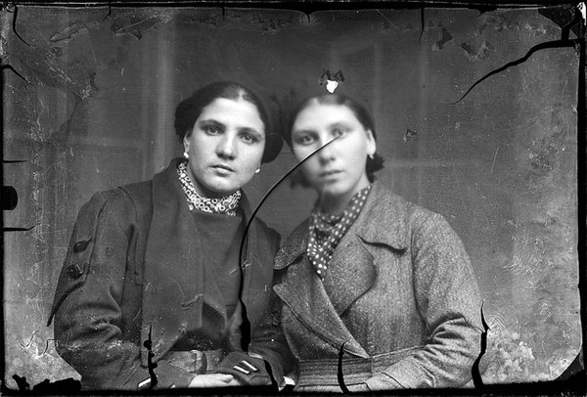
Journal entry #25
“Call it a clan, call it a network, call it a tribe, call it a family. Whatever you call it, whoever you are, you need one.” — Jane Howard

Slide 30
Journal entry #26
A figure in a red hoodie stepped out of the dark alley with…
It all started when Alex McCombrin walked into my shop, the Perk, and slammed his business card on the counter. My part-time student associate, Miley looked at him with the startled gaze of deer, “Could I help you with something, sir?” Before he could answer Miley’s phone tweeped and she…

Slide 31
Journal entry #27
The Dirty Dozen: Write something using these 24 words. The order of the words can be switched around as necessary. The choice of whether you write fiction or non-fiction is up to you. And don’t use all the words in the first sentence. You must use 12 of the 24 words.
bond
grease
shutters
unhappy
money
hang
upstairs
bleary-eyed
slacks
freaked
sleepless
Steelers
running
tank
linen
raspy
straggler
amends
field
tower
bandanna
roped
sidelong
haul

Slide 32
Journal entry #28
“Yesterday I was clever and tried to change the world. Today I am wise and try to change myself.”
~ Rumi

Slide 33
Journal entry #29
When you are as rich as I am it is easy to live an adventurous life. Just yesterday I took off in the company jet and went…
My name is Miranda Harkness and for four hours a day I work as an online computer tech helping inexperienced computer users navigate their systems. I get paid well enough to cover the basics which is all any body ever really needs. My real job comes when the sun goes down, unfortunately vampire hunter doesn’t pay well. At least not until now…

Slide 34
Journal entry #30
“Only after the last tree has been cut down. Only after the last river has been poisoned. Only after the last fish has been caught. Only then will you find that money cannot be eaten.” ~ Prophecy of the Cree Native American Tribe

Slide 35
Journal entry #31
She kept picking at it. First her index finger to gain entry. Followed by all of them. Digging deeper and deeper despite the increasing pain. Logically she knew she should stop. It kept…
Her eyes followed the line of the shiny tools laid strategically from left to right on the wooden table in front of her. The tips of her fingers wandered over the handles as if trying to decide which one felt…”

Slide 36
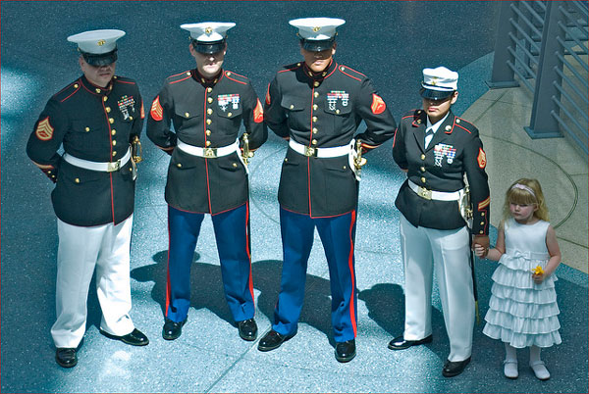
Journal entry #32
“Of all sad words of mouth or pen, the saddest are these: it might have been.”
~ John Greenleaf Whittier

Slide 37
Journal entry #33
When I think of my mother, the first that comes to mind is her hands. There were never particular feminine looking like most women’s hands. Years of use on the farm and later as a barmaid made her hands incredibly strong. There were fearsome things, always…
It all started when I was arrested for shooting Malcolm Mancuso. It was an accident, of course, but part of me can’t help feeling like he deserved it. It all started the night he…

Slide 38
Journal entry #34
The Dirty Dozen: Write something using these 24 words. The order of the words can be switched around as necessary. The choice of whether you write fiction or non-fiction is up to you. And don’t use all the words in the first sentence. You must use 12 of the 24 words.
pineapple
overwrought
backpack
aptitude
knotted
fabricated
culture
lifeless
windows
juniper
long-drawn-out
piercing
Nana
savings
axed
partners
forensics
target
level-headed
Amish
enactment
confined
displeasing
sponge

Slide 39
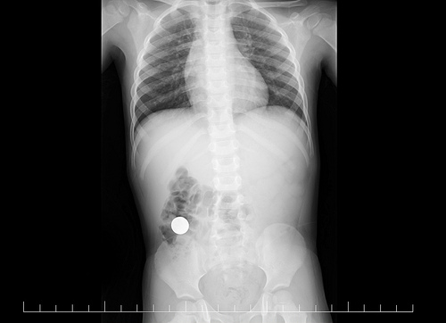
Journal entry #35
“Nuclear warfare is like two men standing in a pool of gasoline, one with five matches, the other with two.”
~ Carl Sagan

Slide 40
Journal entry #36
The day we decided to clone an extinct animal was the day life as we knew it was changed forever. With the genetic information we had at our fingertips nothing prepared us for…
It was 1986. The Fly was in the theater and The Phantom of the Opera was a musical. I hadn’t seen either of them. My mom dressed me in the most hideous pink frock with puffy sleeves and…

Slide 41
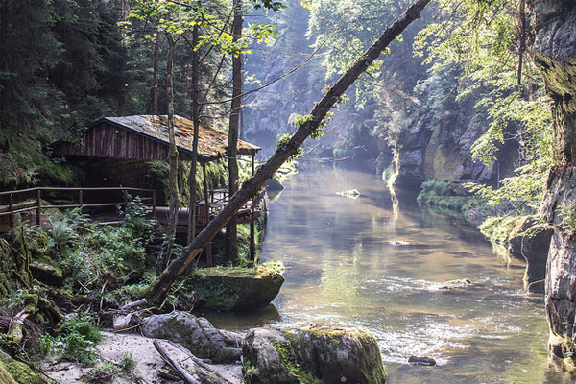
Journal entry #37
“Be humble for you are made of earth. Be noble for you are made of stars.” ~ Serbian proverb

Slide 42
Journal entry #38
Mary-Ellen Stewart was a little light in the head. She always had a grin on her face, spoke loudly and often inappropriately but no one really seem to mind. There was an endearing, lovable quality to her and her smile was infectious. I was seventeen years old the summer she disappeared and twenty-four the spring she turned up. It was…
The first thing he does when he leans over is blow in my face. Not a soft gentle blow either, more like a hard quick puff. I blinked quickly and refocused on his deep teal eyes. “Why did you do that?” I asked…

Slide 43
Journal entry #39
The Dirty Dozen: Write something using these 24 words. The order of the words can be switched around as necessary. The choice of whether you write fiction or non-fiction is up to you. And don’t use all the words in the first sentence. You must use 12 of the 24 words.
bucolic
overwrought
disassembled
elixir
relieved
murmur
grapes
cheesy
epiphany
garage
posting
shrill
court
sideboard
fragile
obstructed
inventor
exhumed
strawberry
aromatic
butcher
muddy
smothered
drained

Slide 44
Journal entry #40
“When you’re good at something, you’ll tell everyone. When you’re great at something, they’ll tell you.” ~ Walter Payton

Slide 45
Journal entry #41
I hate clowns. But mostly I hate people who make me explain why I hate clowns and the look on their face when I…
He was lying face down on the raft. At first we thought he was sleeping with his head using the inflated side as a pillow and one hand hanging over grazing the water’s edge but then the…

Slide 46
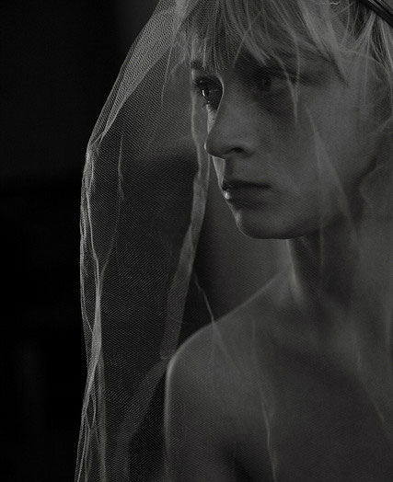
Journal entry #42
“Give a man a mask, and he will show you his true face.” ~ Oscar Wilde

Slide 47
Journal entry #43
The room was cold. Marcus Waterman thought he’d put on slippers if he could move. He’d ask for some wool socks if he did not have a tube down his throat. He could hear the shuffle of paper sheets and the clatter of metal objects. He could see light behind the dull shade of his eyes. At times he thought he could hear voices or the din of conversation but no one word stood out. For him…
At 8:15 a.m. EST on December 28, 2413 the President of the United States interrupted regular programming to apologize for…

Slide 48
Journal entry #44
The Dirty Dozen: Write something using these 24 words. The order of the words can be switched around as necessary. The choice of whether you write fiction or non-fiction is up to you. And don’t use all the words in the first sentence. You must use 12 of the 24 words.
lecturer
science
paradox
sentimental
conduct
neophyte
drawn
beer
inn
gateway
drafts
socks
extreme
Japan
halter
singing
fingertips
struggle
crescendo
tame
computer
ivy
remove
commitment

Slide 49
Journal entry #45
“Isn’t it funny how day by day nothing changes, but when we look back everything is different.”
~ C.S. Lewis

Slide 50
Journal entry #46
My roommate is a slob. Fortunately, I am not home most of the time for it to really grate me but I have on occasion fought back the taste of vomit. One time I found a…
The harder she scratch away at her forearm the quicker the flesh fell away. From outside the containment unit Dr. Elena Miles and Dr. Mark Rustenburg watched on dismay as the …

Slide 51
Journal entry #47
“The reason we struggle with insecurity is because we compare our behind-the-scenes with everyone else’s highlight reel.” ~ Steven Furtick

Slide 52
Journal entry #48
My name is Kyle Dearborn. I am an architect from California, living in New Mexico. I’m thirty-four years old, single but looking. Two days ago I killed someone and I haven’t been able to…
Damon pressed his thumb and forefinger of his right hand into the inner corners of his closed eyes hoping to provide some relief from the pain that throbbed there. His doctor had given him a new medication to try, phito-something-no-on-could-spell but it didn’t seem to be touching it. Any longer and he’d have to…

Slide 53
Journal entry #49
The Dirty Dozen: Write something using these 24 words. The order of the words can be switched around as necessary. The choice of whether you write fiction or non-fiction is up to you. And don’t use all the words in the first sentence. You must use 12 of the 24 words.
green
nanny
cake
marigolds
mushy
safe
pathological
abstract
whistle
footing
coils
hay
jackhammer
sacrifice
dogged
competing
fresh
dew
bible
hypocrite
tunnel
murky
shivers
grafted

Slide 54
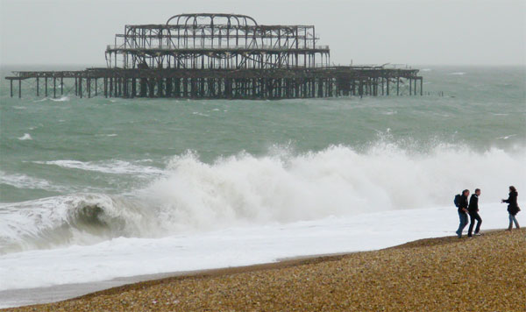
Journal entry #50
“Never underestimate the power of stupid people in large numbers.” – Unknown

Slide 55
Journal entry #51
When Johnny and I were eight years old we found a treasure chest buried in the silky sands behind our grandfather’s beach house. We thought we had struck it rich, we didn’t even notice that all the coins, copper pennies, were dated within the last ten years. Our father was good like that, creating moments for my brother and I to …
“You are not welcome here John,” said Milo Davis as he stood with palm raised like a wall in front of him.
“Where am I to go old friend?”
“That stopped being my concern when you…

Slide 56
Journal entry #52
“The greater danger for most of us is not that our aim is too high and we miss it, but that it is too low and we reach it.” – Michelangelo Buonarroti

Slide 57
Journal entry #53
“I eat lizards for breakfast,” said the old man behind the counter. Charlotte Stone stared at him for a moment trying to decide whether the man was full of beans or not. He winked at her in jest but she decided he wasn’t. “Um, do you have a map of…

Slide 58
Journal entry #54
When you go into survival mode your brain does not necessarily do logical things. For example, the first time the power went out in my new house I filled up all the sinks and tub with…
On my journey cross country by train I had the opportunity to meet a man who would change my life forever. His name was…

Slide 59
Journal entry #55
“What in your life is calling you? When all the noise is silenced, the meetings adjourned, the lists laid aside, and the wild iris blooms by itself in the dark forest, what still pulls on your soul? In the silence between your heartbeats hides a summons, do you hear it? Name it, if you must, or leave it forever nameless, but why pretend it is not there?” — The Terma Collective

